Slide 1
Complex Variable, Laplace &
Z- transformation
Lecture 01

Slide 2
Applications of Laplace Transformation
1
2
3
4
5
Laplace Transformation
Is widely used by electronic engineers to solve quickly differential equations occurring in the analysis of electronic circuits.
We employ Laplace Transform to solve digital signal processing problem.
In order to get true form of radioactive decay Laplace Transform is used. It makes easy to study analytic part of nuclear physics.
Laplace Transform is used to simplify calculations in system modeling, where large number of differential equations are used.
Ordinary Differential equations can be easily solved by the Laplace Transform method without finding the general solution and the arbitrary constants.

Slide 3

Definition of Laplace Transformation
Let the function $f(t)$ be defined for all positive values of$t$, then multiply $f(t)$by$e^{−st}$ and integrate it with respect to $t$ from zero to infinity. If the resulting integral exists (i.e., has some finite value), it is a function of$s$,$s$ may be real or complex, say$F(s)$.
$$F\left(s\right)=\int_{0}^{∞}{e^{−st}f\left(t\right)dt}.$$
This function $F(s)$ of variable $s$ is called Laplace Transformation of the original function $f(t)$ and will be denoted by$ℒ\left\{f\left(t\right)\right\}$, where $ℒ$ denotes the Laplace transform operator.

Slide 4
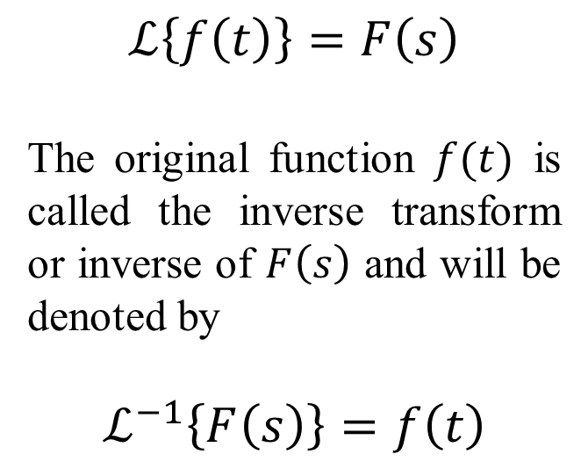

Important Notation of
Laplace Transformation
Important Formulae of
Laplace Transformation
$$ℒ\left\{f\left(t\right)\right\}=F\left(s\right)$$
The original function $f(t)$ is called the inverse transform or inverse of $F\left(s\right)$ and will be denoted by
$$ℒ^{−1}\left\{F\left(s\right)\right\}=f\left(t\right)$$
$$1.ℒ\left\{c\right\}= \frac{c}{s}, c is any constant, (s>0)$$
$2.ℒ\left\{t^{n}\right\}= \frac{n!}{s^{n+1}}$, when$n=0,1,2,3,..$
$$3.ℒ\left\{e^{at}\right\}= \frac{1}{s−a}, \left(s>a\right)$$
4. $ℒ\left\{\cos{at}\right\}=\frac{s}{s^{2}+a^{2}}$
5. $ℒ\left\{\sin{at}\right\}=\frac{a}{s^{2}+a^{2}}$
6. $ℒ\left\{\cosh{at}\right\}=\frac{s}{s^{2}−a^{2}}$
7. $ℒ\left\{\sinh{at}\right\}=\frac{a}{s^{2}−a^{2}}$

Slide 5



Some workout Examples of Laplace Transformation using direct formula
Example: 1
$$ℒ\left\{(t^{2}+1)^{2}\right\}$$
$$=ℒ\left\{t^{4}+2t^{2}+1\right\}$$
$$=ℒ\left\{t^{4}\right\}+2ℒ\left\{t^{2}\right\}+ℒ\left\{1\right\}$$
$$=\frac{4!}{s^{4+1}}+2\frac{2!}{s^{2+1}}+\frac{1}{s}$$
$$=\frac{24}{s^{5}}+\frac{4}{s^{3}}+\frac{1}{s}$$
Example: 3
$$ℒ\left\{\cos^{2}{3t}\right\}$$
$$=ℒ\left\{\frac{1}{2}(1+\cos{6t})\right\}$$
$=ℒ\left\{\frac{1}{2}\right\}+\frac{1}{2} ℒ\left\{\cos{6t}\right\}$
$$=\frac{1}{2s}+\frac{1}{2}\left(\frac{s}{s^{2}+36}\right)$$
Example: 2
$$ℒ\left\{e^{−3t}+5\cosh{t}\right\}$$
$$={ℒ\{e}^{−3t}\}+5ℒ\{cosh{ t\}}$$
$$=\frac{1}{s−(−3)}+5\frac{s}{s^{2}−1^{2}}$$
$$=\frac{1}{s+3}+\frac{5s}{s^{2}−1}$$

Slide 6


Sample Exercise Set on Laplace Transformation using direct formula
Find the Laplace Transforms and also sketch (if free hand sketching is getting complex then use MATLAB) the following functions (1-8):
$$1. f\left(t\right)=3t+12,$$
$2. f\left(t\right)=e^{5t},$
3. $f\left(t\right)=e^{−2t},$
4. $f\left(t\right)={\left(a−bt\right)}^{2},$
5.$f\left(t\right)=\cos{πt,}$
6. $f\left(t\right)=\cos^{2}{ωt,}$
7. $f\left(t\right)=\sin\left(ωt+θ\right),$
8. $f\left(t\right)=1.5\sin\left(3t−\frac{π}{2}\right),$

Slide 7
Learning Outcomes of Laplace Transformation
The original main use of Laplace transform is to solve initial value problems for linear ordinary and partial differential equations. They can reduce ordinary differential equations to algebraic equations, and partial differential equations to ordinary differential equations. The transformed equations are easier to solve, and then the solution in the Laplace domain is transformed back to the time domain

Slide 8













Sample MCQ
What is $ℒ\left\{\cos{at}\right\}?$
(a) $\frac{a}{s^{2}+a^{2}}$
(b) $\frac{a}{s^{2}−a^{2}}$
(c) $\frac{s}{s^{2}+a^{2}}$
(a) $\frac{s}{s^{2}−a^{2}}$
2. What is $ℒ\left\{t\right\}$ ?
(a) $\frac{1}{s^{2}}$
(b) $\frac{1}{s}$
(c) $\frac{1}{s+1}$
(d) $\frac{1}{s−1}$
3. $ℒ\left\{\sin\left(ωt+θ\right)\right\}=?$
(a) $\frac{ω\cos{θ + s \sin{θ}} }{ω^{2} +{ s}^{2}}$
(b) $\frac{ω\cos{θ + s \sin{θ}} }{ω^{2} +{ s}^{2}}$
(c)$\frac{ω\cos{θ + s \sin{θ}} }{ω^{2} +{ s}^{2}}$
(d)$\frac{ω\cos{θ + s \sin{θ}} }{ω^{2} +{ s}^{2}}$

